Slide 1
Ch10. Bluetooth App making
1) Dog barking
2) Doodle
3) Bluetooth LED control App making
4) Bluetooth auto paring
5) Bluetooth Servo motor control App

Slide 2

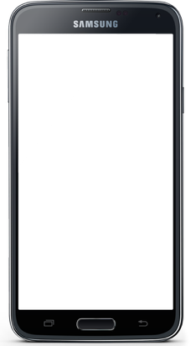

Dog barking

Slide 3

1) Barking dog
TASK: Create a simple APP
Dog bark sound when touch smartphone window
Barking sound

Slide 4
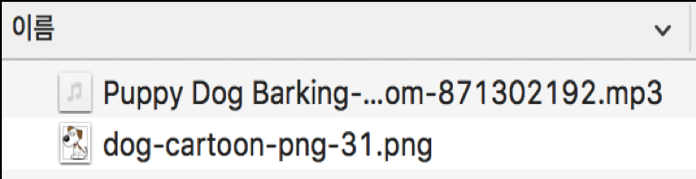
1) Barking dog
Get:
Small size dog
image and sound
Image < 400X400 pixel
Barking sound

Slide 5
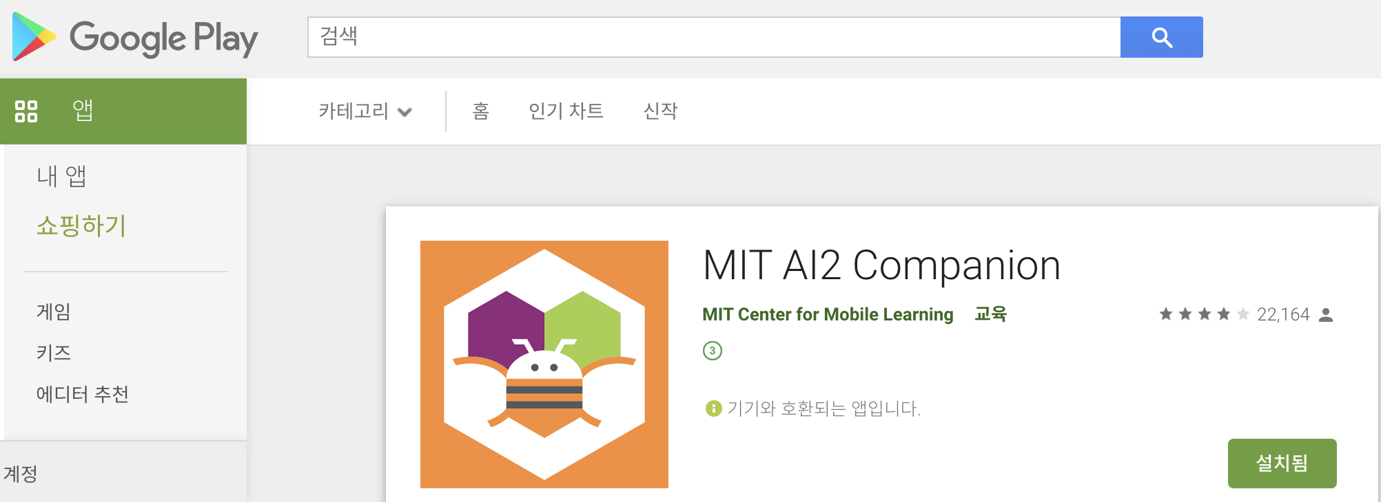
1) Barking dog
Google Play 에서 앱 다운로드

Slide 6
1) Barking dog
Let`s create an Android App

Slide 7
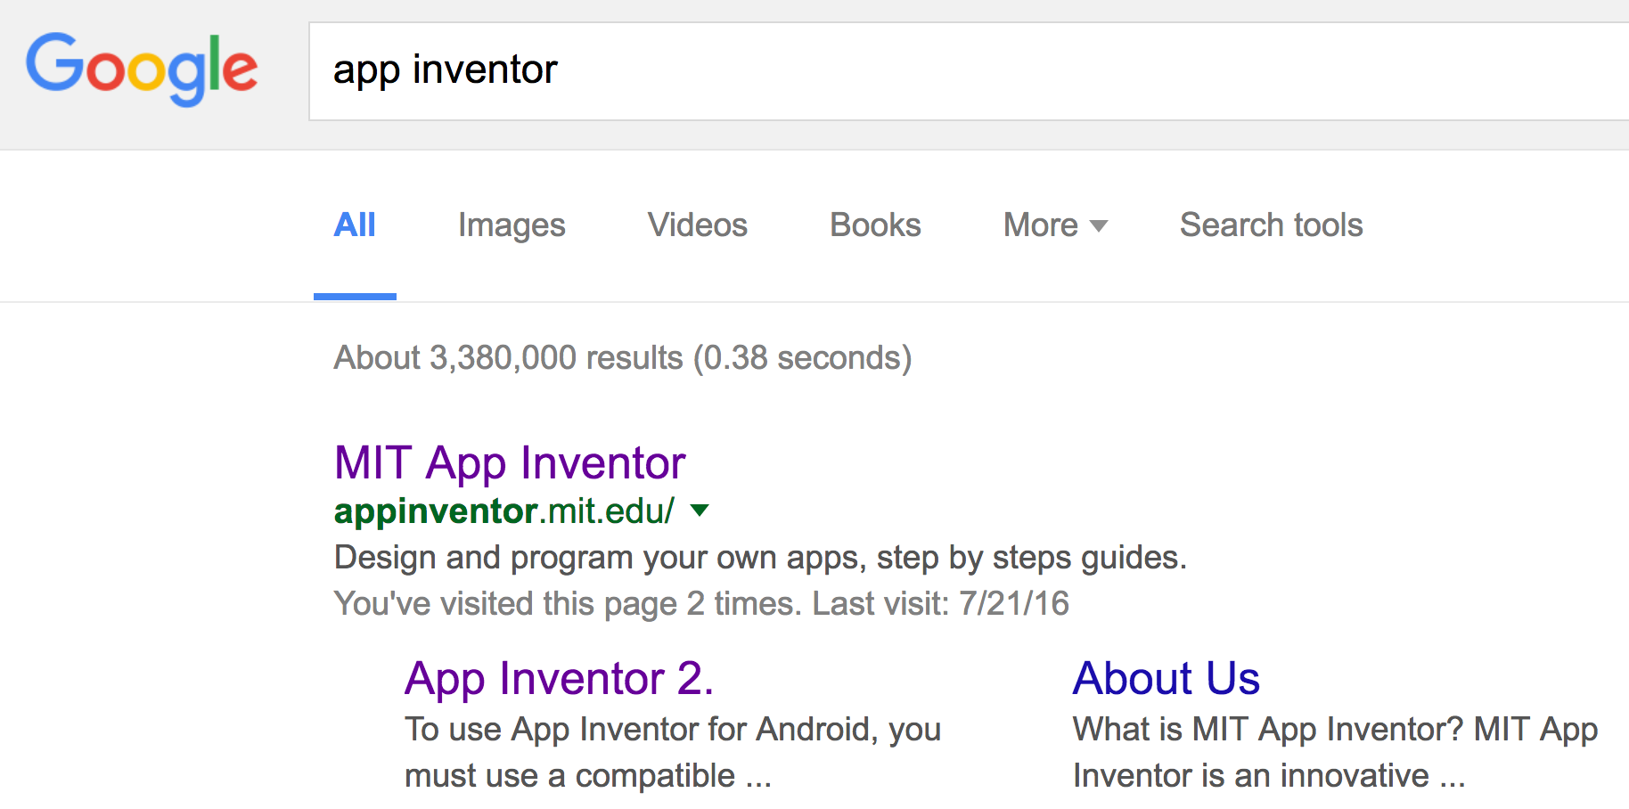
1) Barking dog
Step 1 : Go to app inventor web page

Slide 8
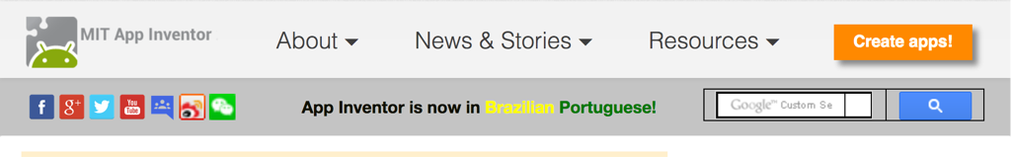
1) Barking dog
Step 2 : Make an account
Step 3 : Begin to create a APP

Slide 9
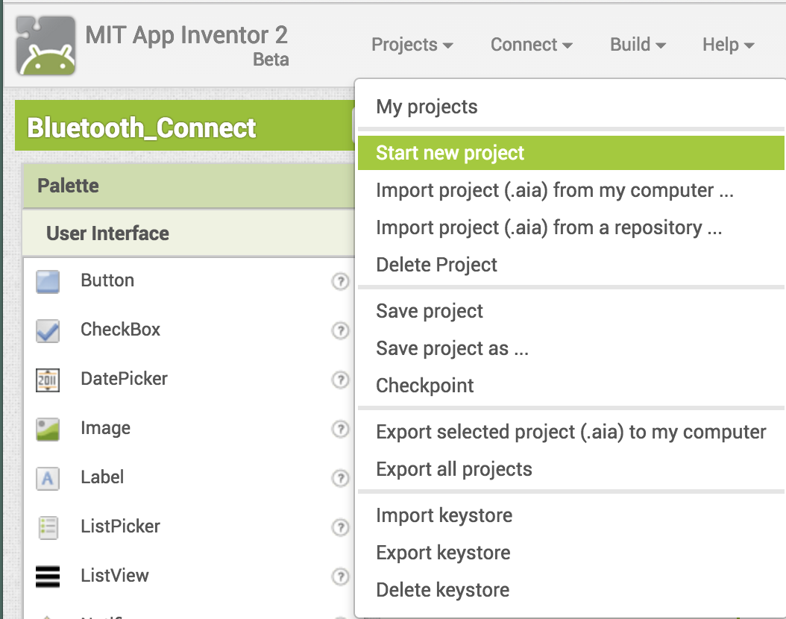
1) Barking dog
클릭

Slide 10
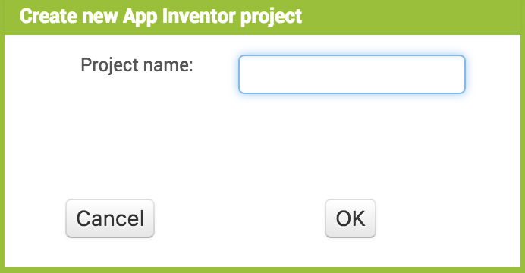
1) Barking dog
프로젝트명
프로젝트명 에는 중간에 스페이스 없게

Slide 11
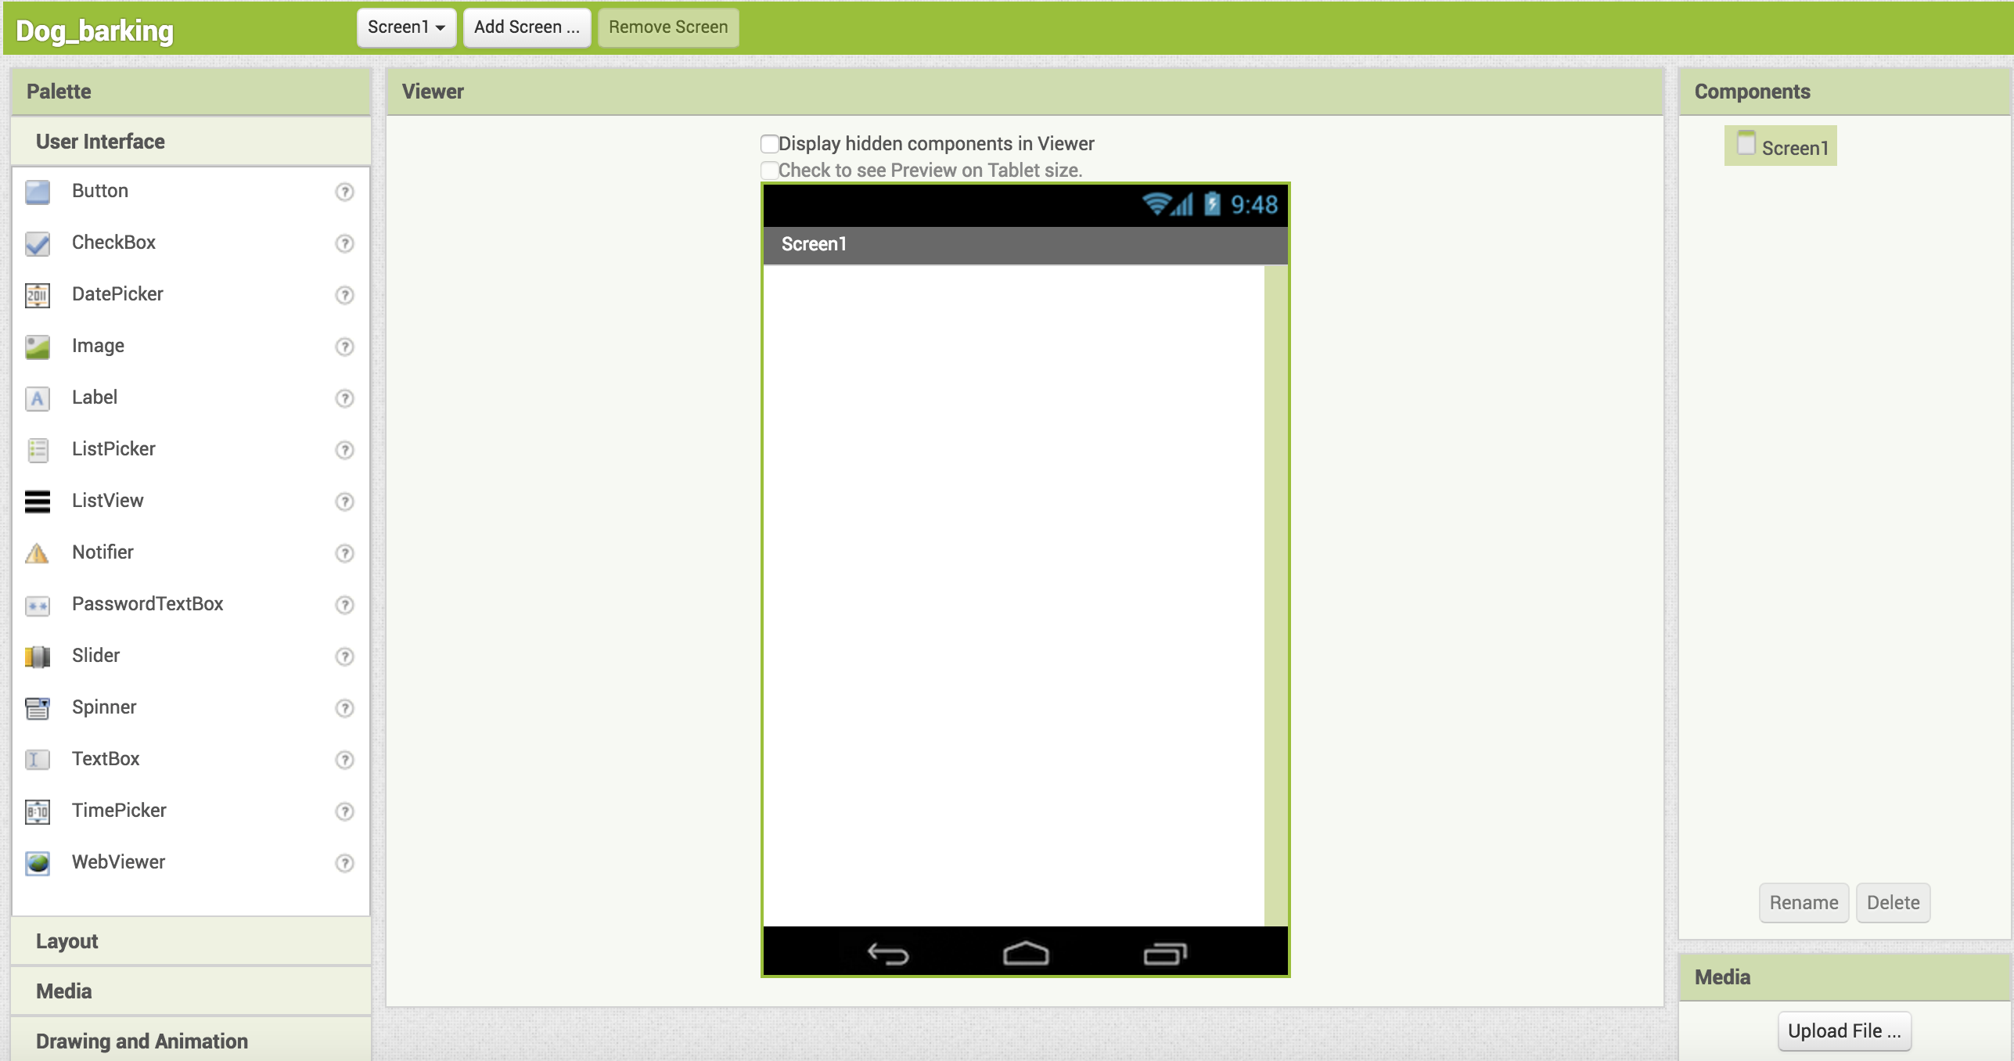
1) Barking dog
앞에서 다운로드한
개 그림과 사운드를 업로드

Slide 12
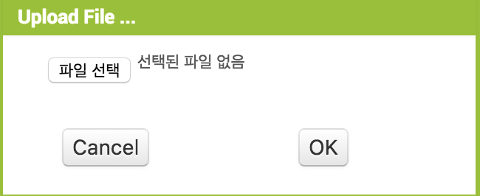
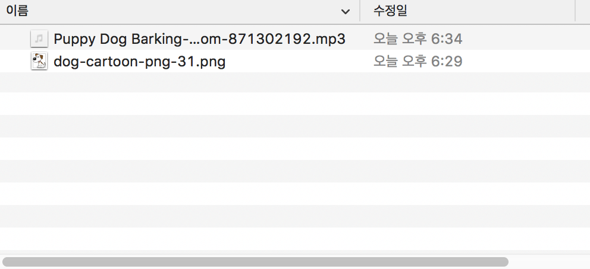
1) Barking dog
Upload files to Media

Slide 13
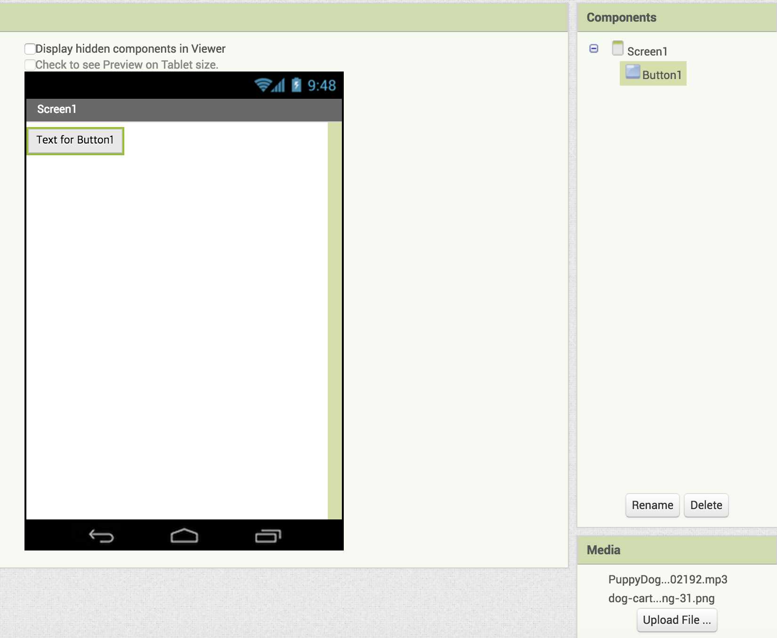
1) Barking dog
Uploaded files to Media

Slide 14
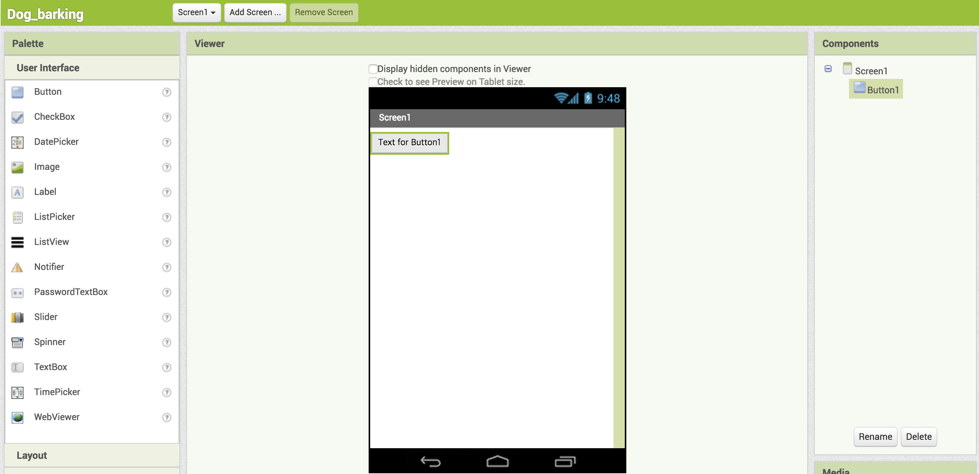
1) Barking dog
Button drag to phone window
Drag and drop
드래그 드롭

Slide 15
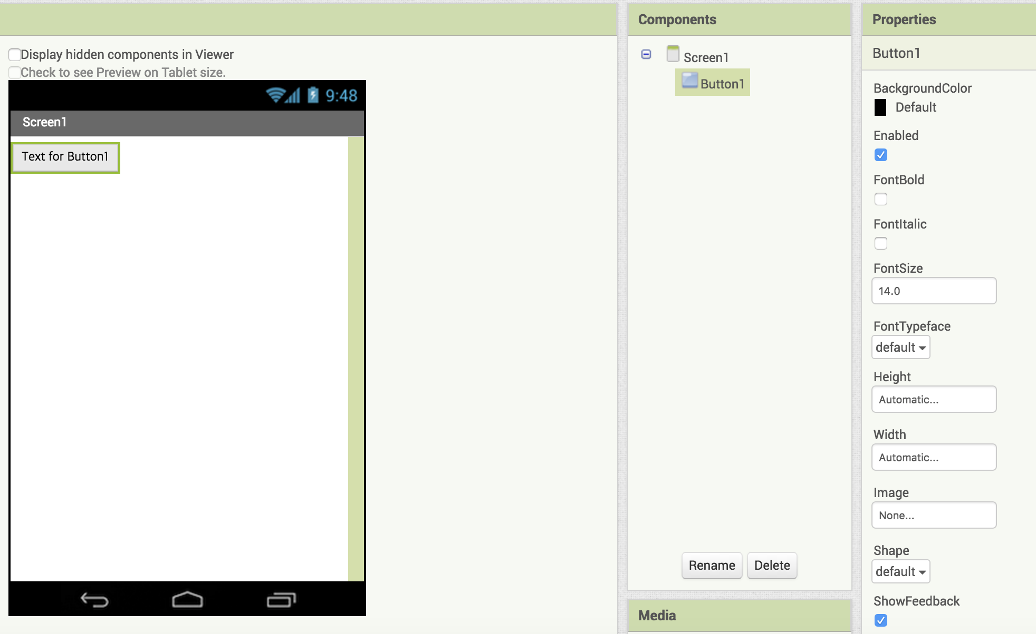
Give properties of the Button as a dog
1) Barking dog
Select dog image from
Media

Slide 16
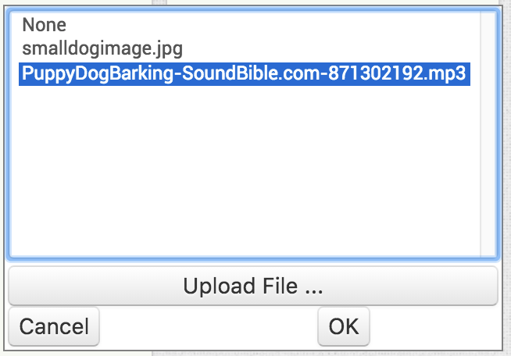
1) Barking dog
Select image of dog
Smalldogimage.jpg

Slide 17
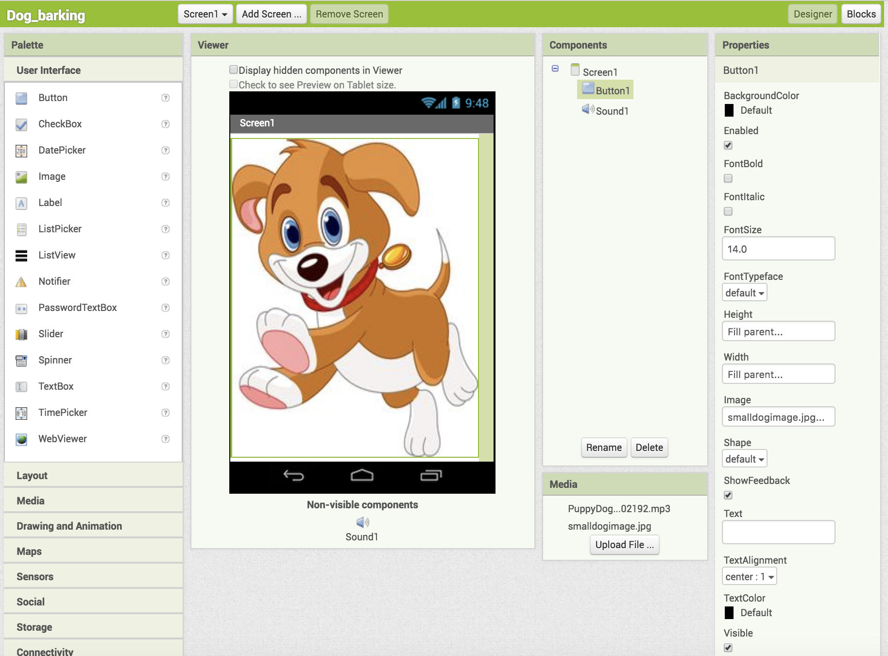
1) Barking dog
Adjust
Height and Width
of image
from Properties

Slide 18
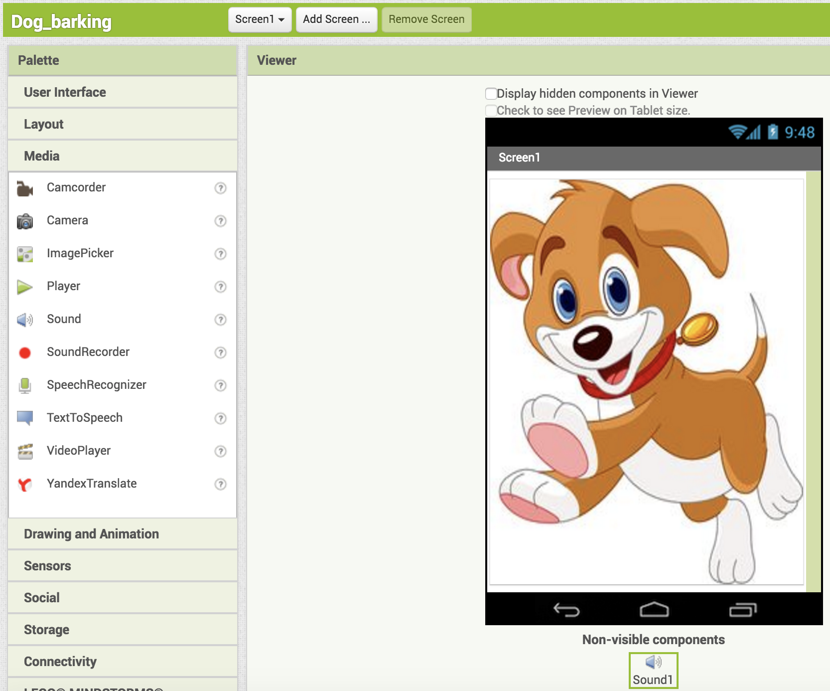
1) Barking dog
Go to Media menu and
and drag Sound icon
to phone

Slide 19
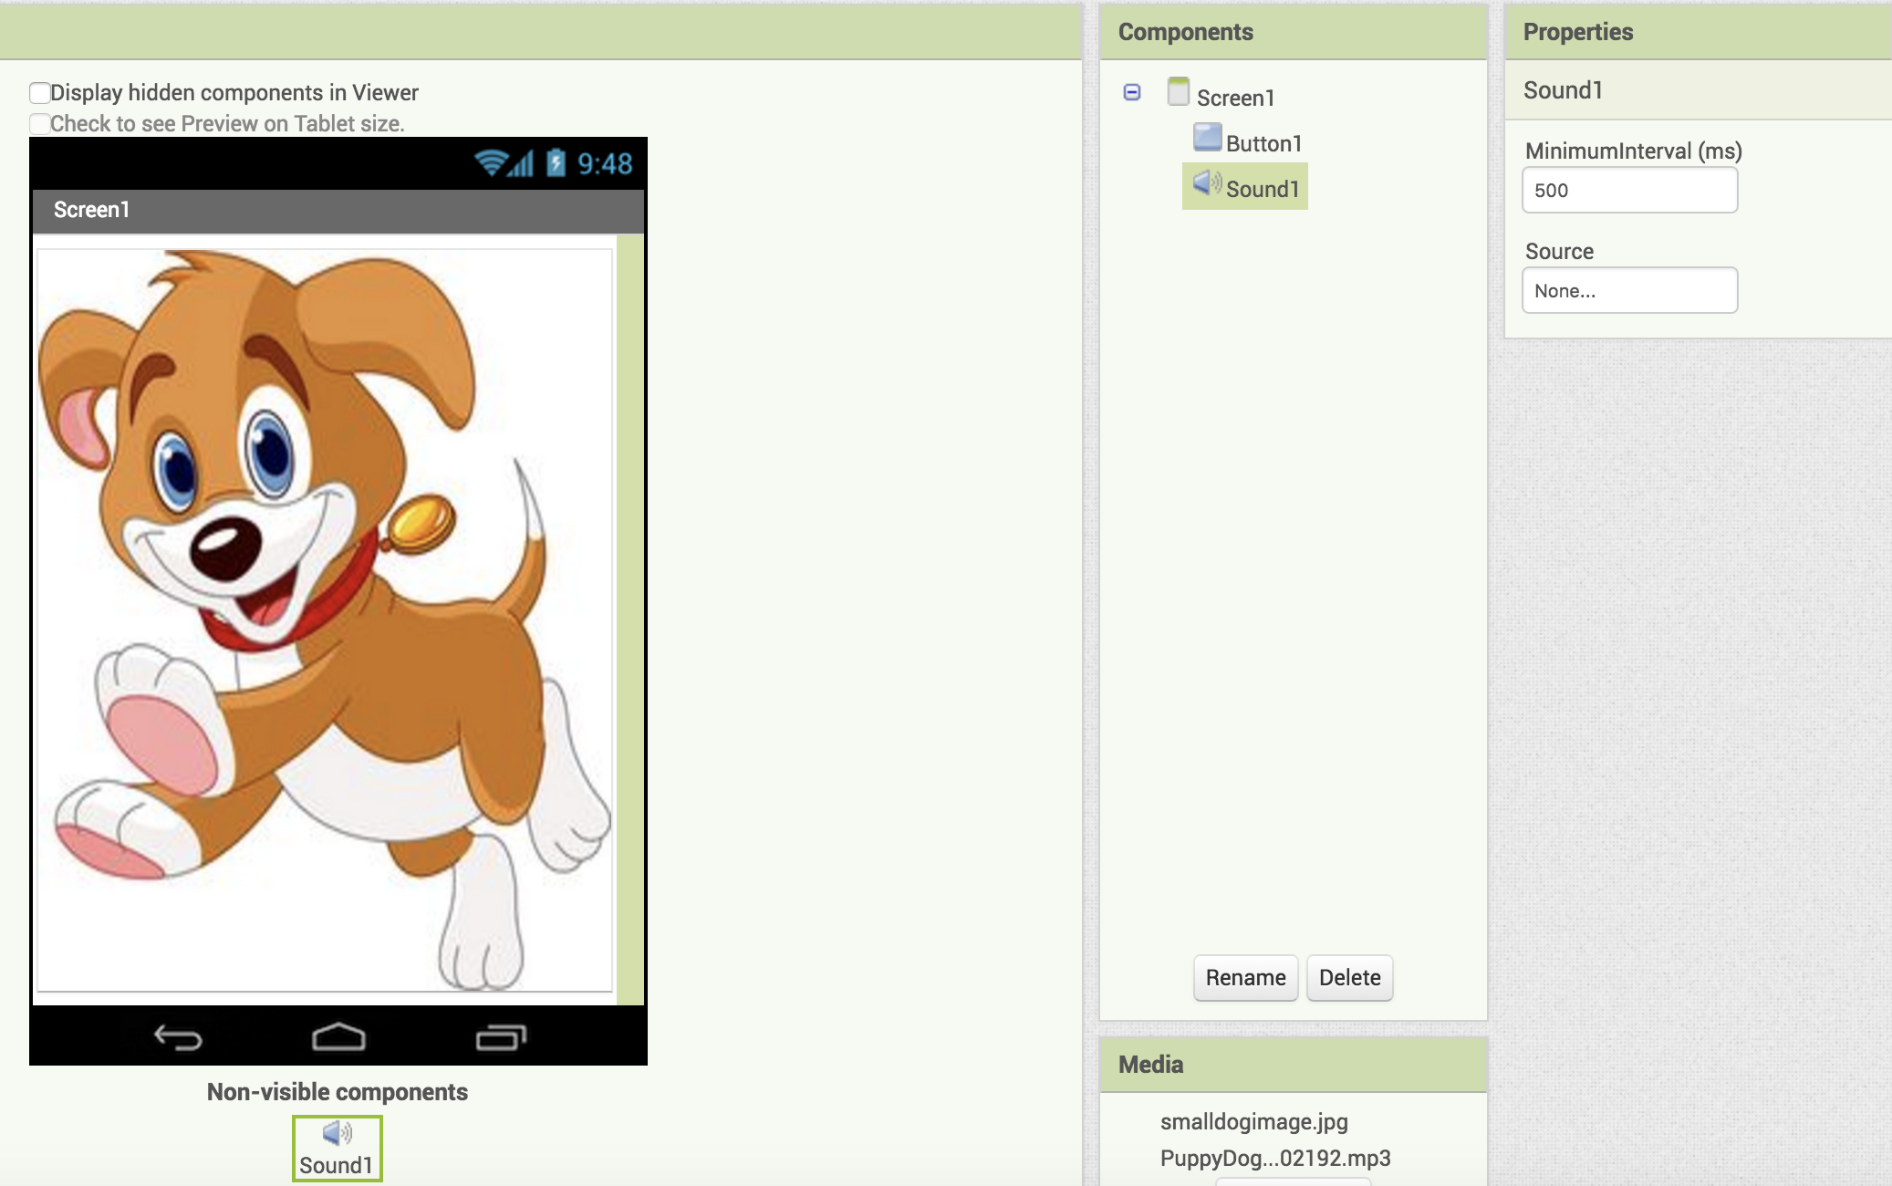
1) Barking dog
Get sound from Media
Select sound from Media

Slide 20
1) Barking dog

Slide 21
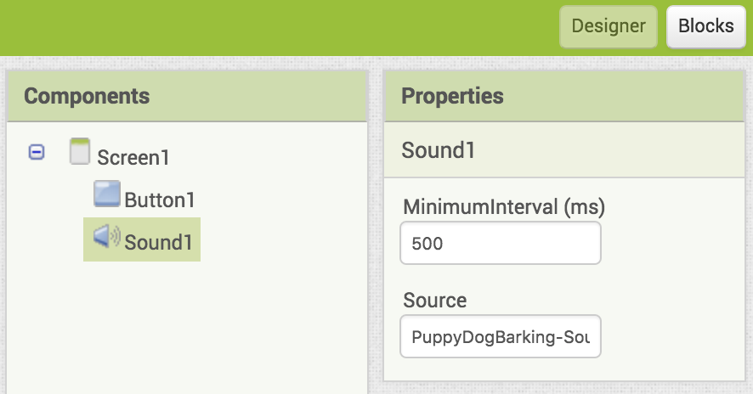
1) Barking dog
Now click Block icon
Located at top right corner

Slide 22
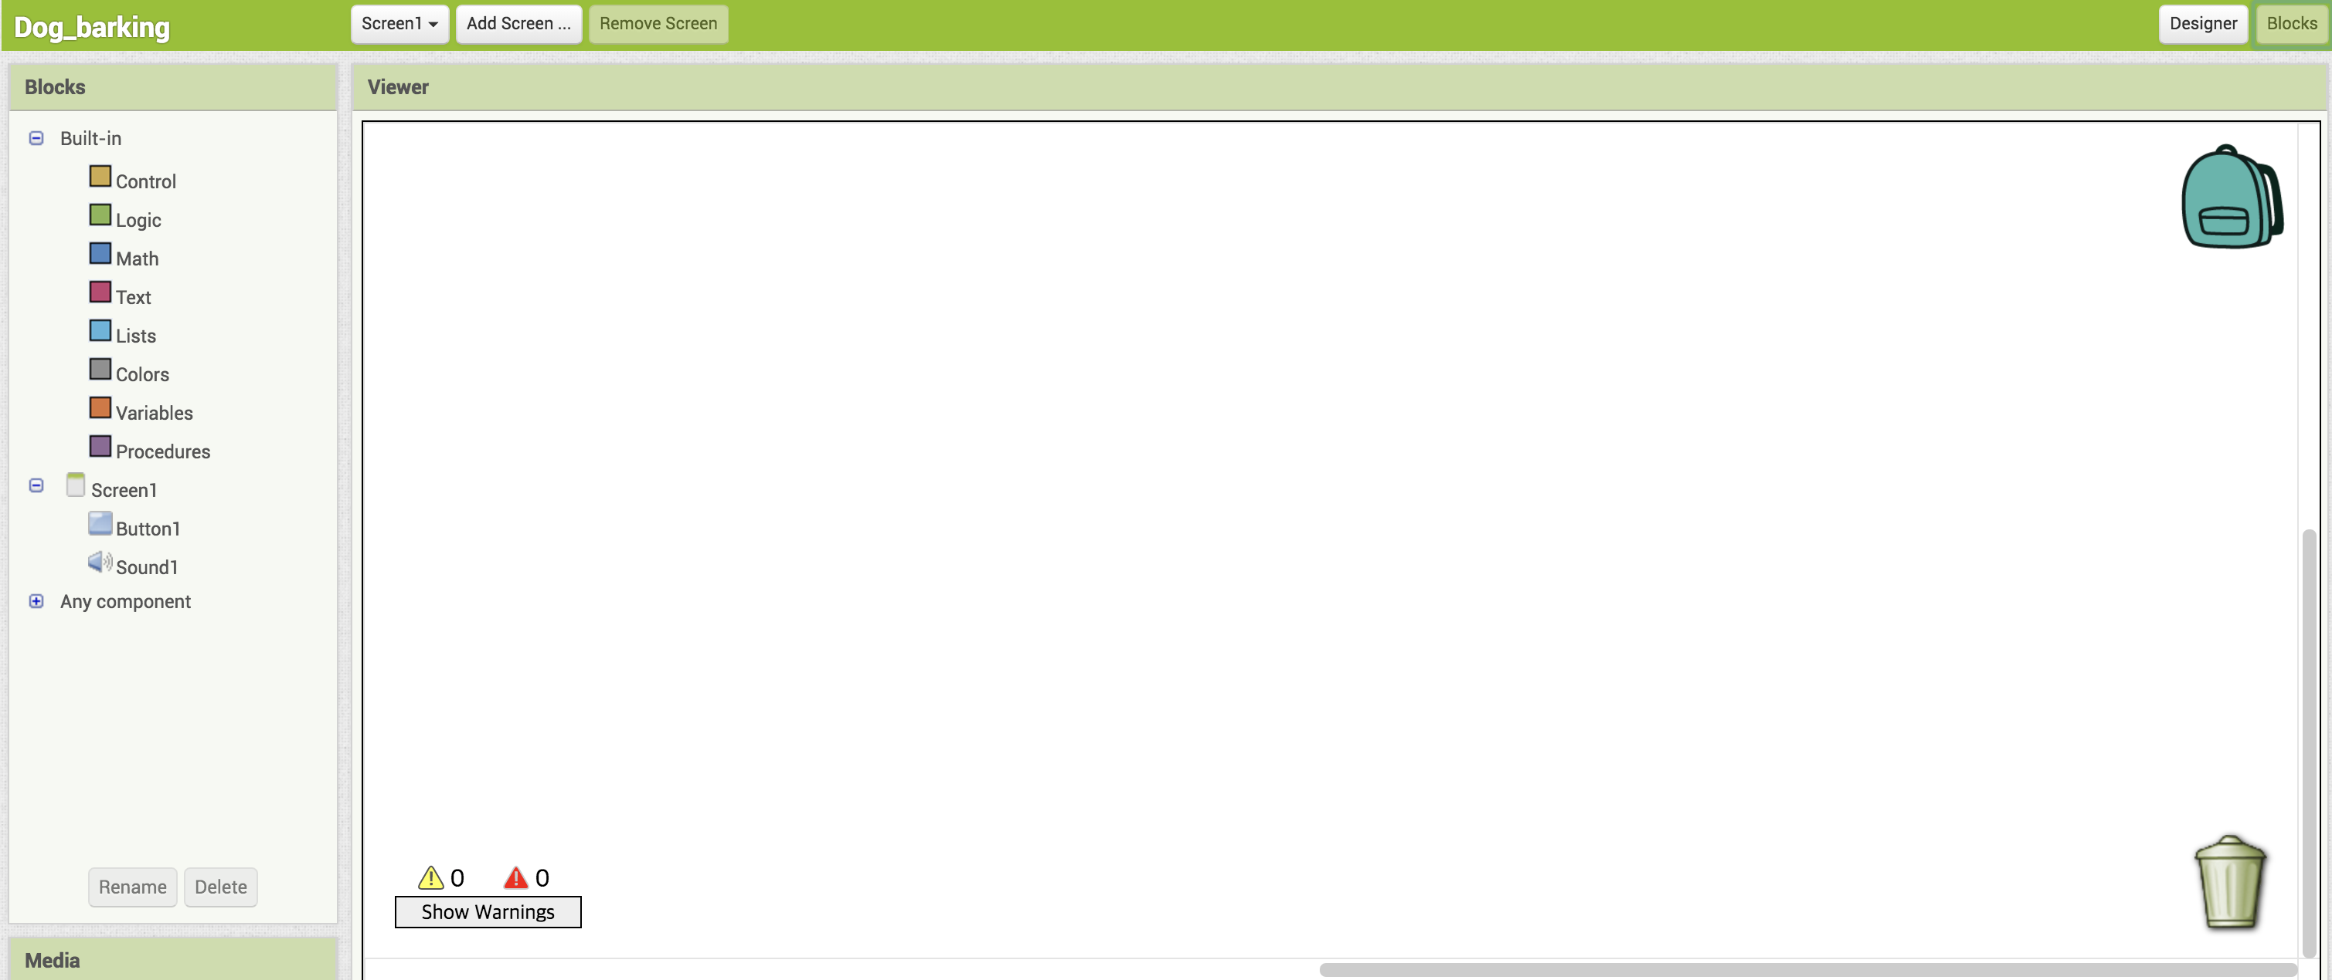
1) Barking dog
Block window view

Slide 23
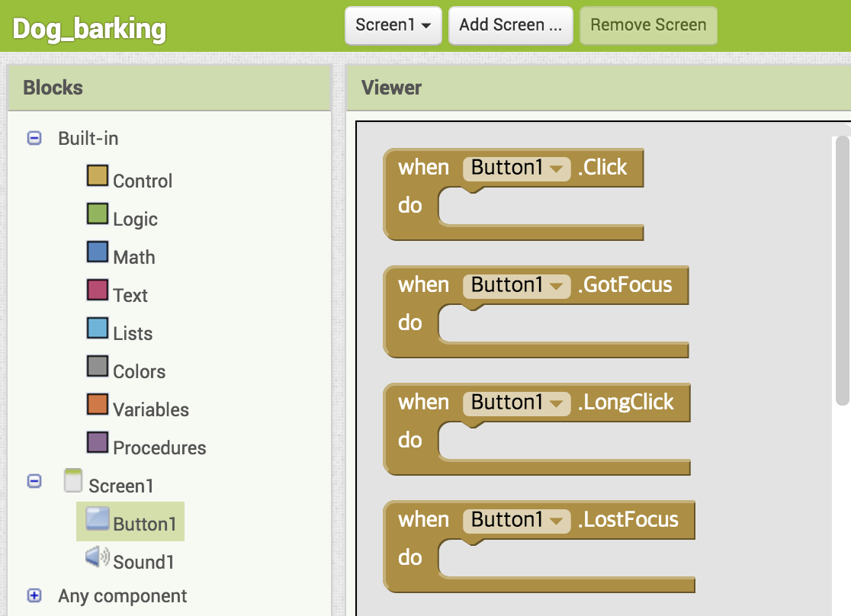
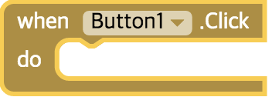
1) Barking dog
Click and drag Block to the window

Slide 24
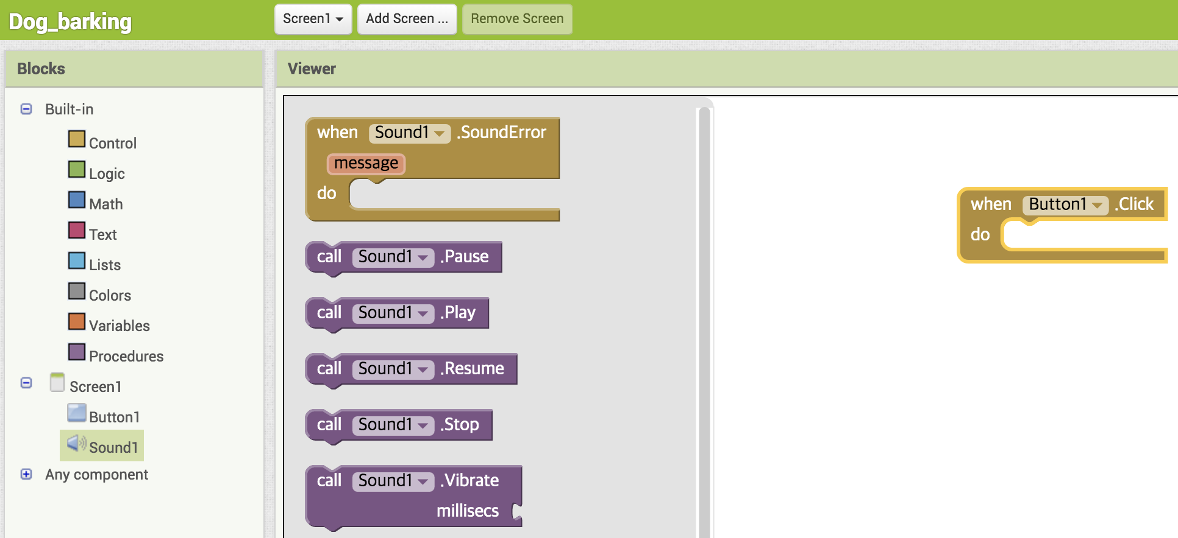
1) Barking dog
From sound palette

Slide 25
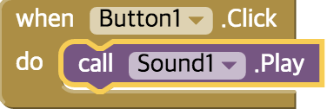
1) Barking dog
Complete block coding

Slide 26
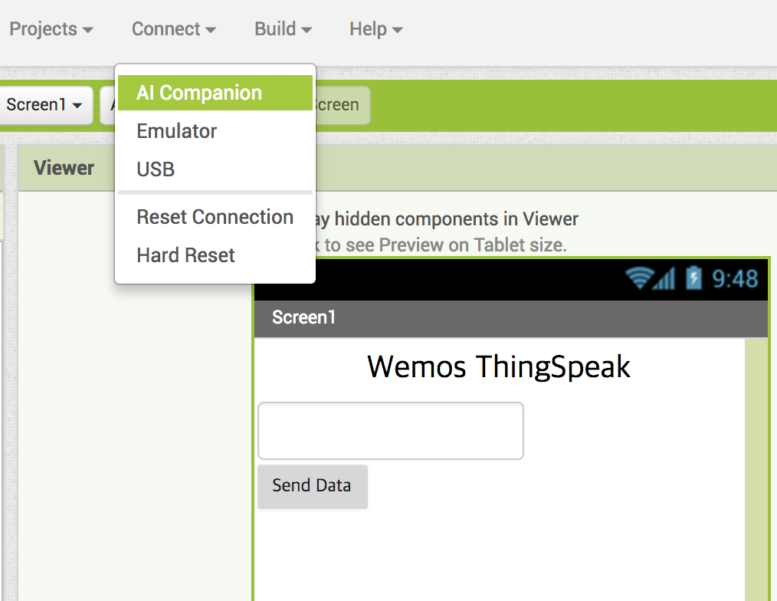
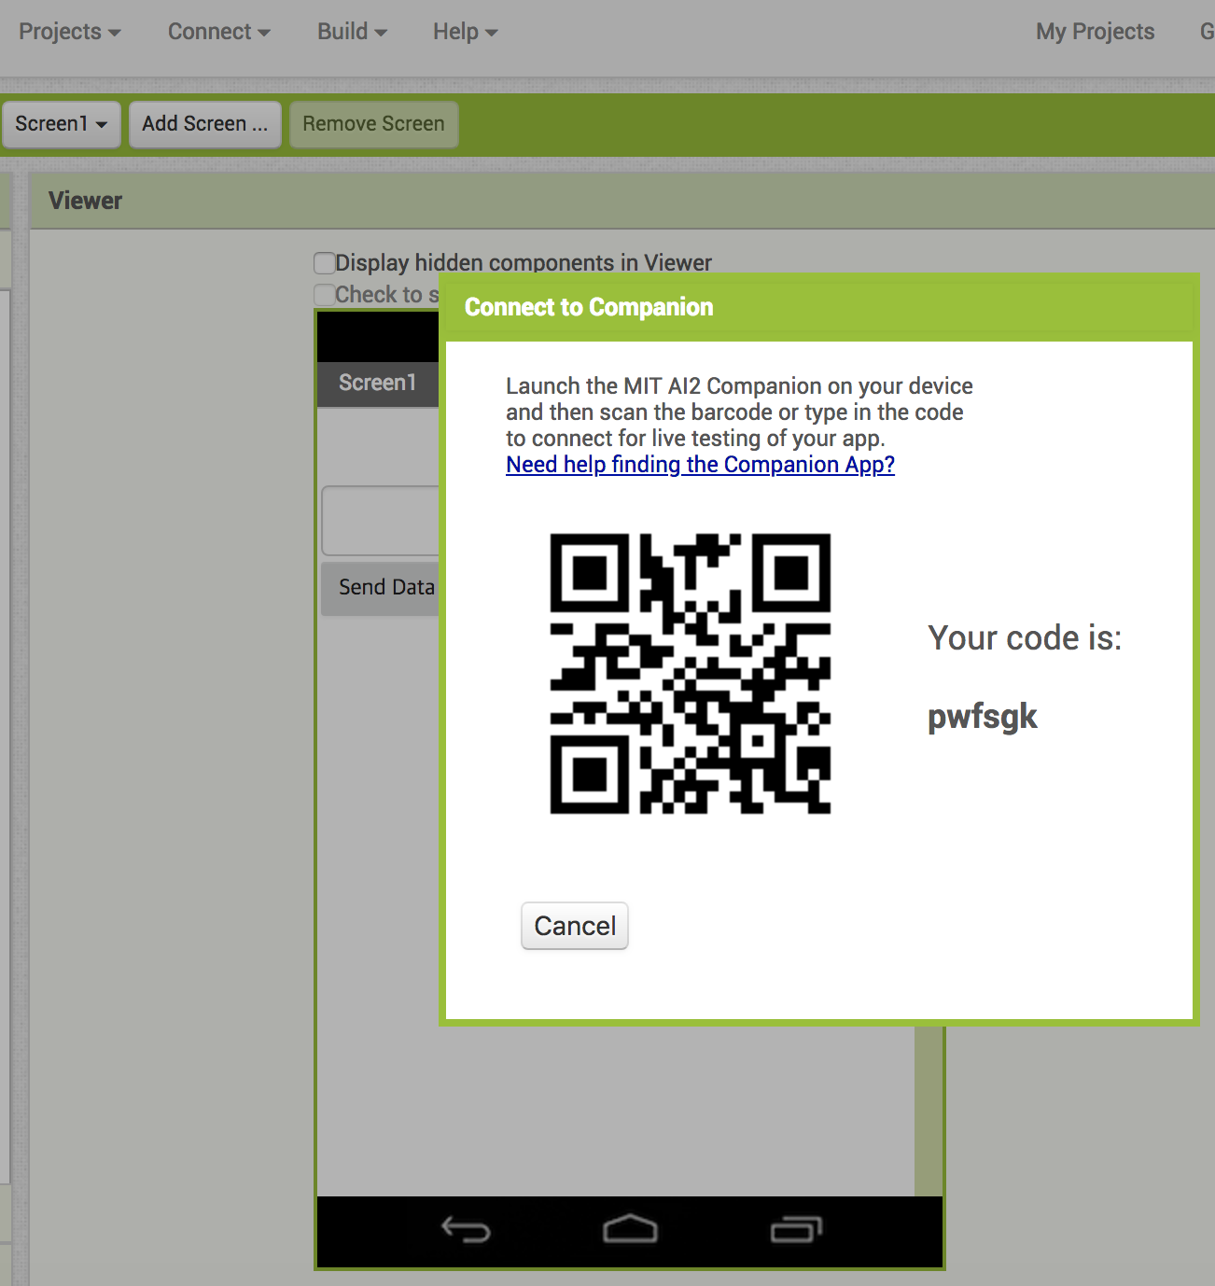
Make connection between your phone and App file

Slide 27
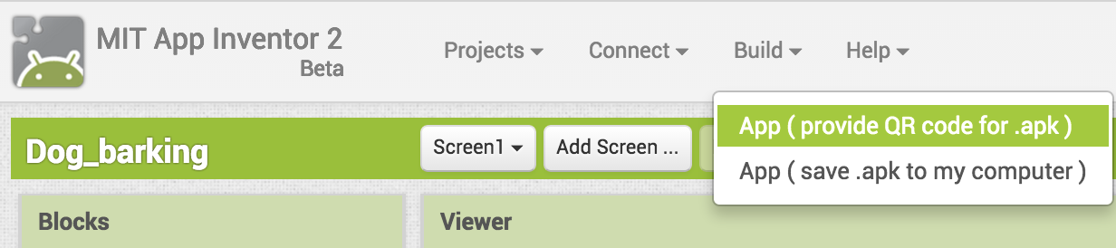
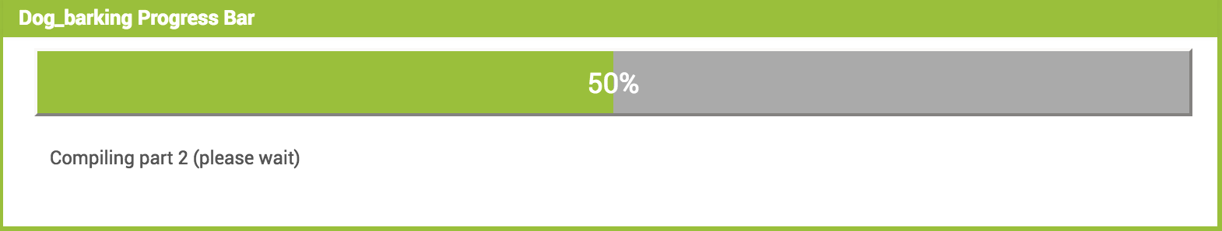
1) Barking dog
Now export this code to phone :
스켄 QR code from phone then 환경 설정에서 앱 허용 or
Save file to your computer then transfer to phone

Slide 28
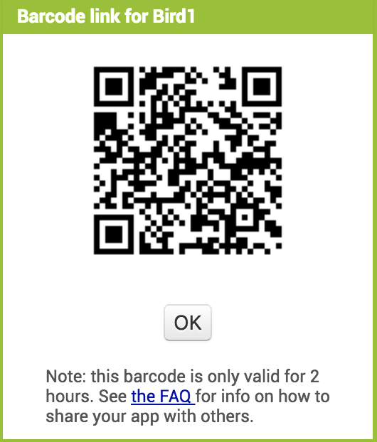
1) Barking dog
컴파일이 끝나면 아래와 같은 QR 코드가 만들어 진다.
컴퓨터와 스마트폰이 같은 WiFi 네트웍을 사용하고 있어야 한다.
그렇지 않을 경우 .apk 파일을 컴퓨터에 다운 받은 다음 유선(케이블)
또는 무선(메일, SNS) 방법등을 사용하여 폰에 가져가면 된다.

Slide 29
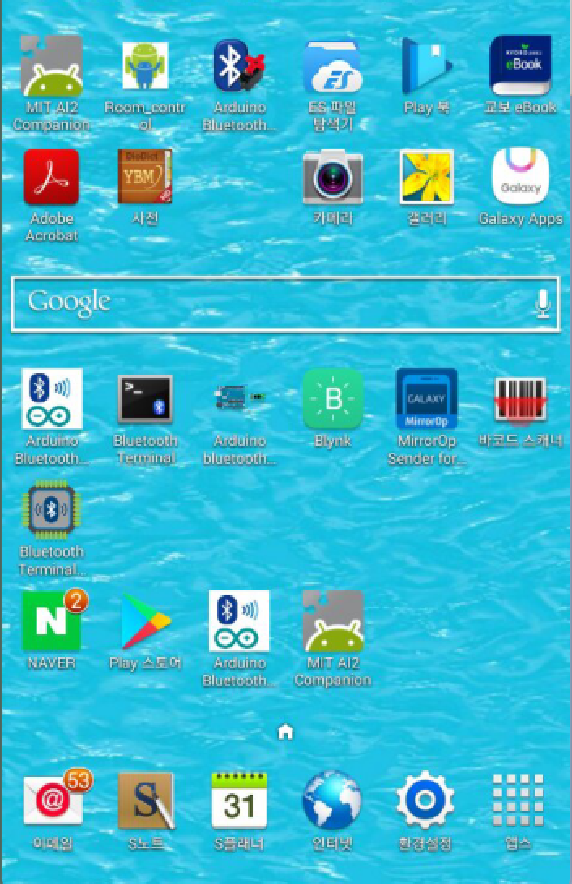
1) Barking dog
QR 코드 스캔 방법
MIT AI2 Companion
앱을 활성화 시킨다

Slide 30
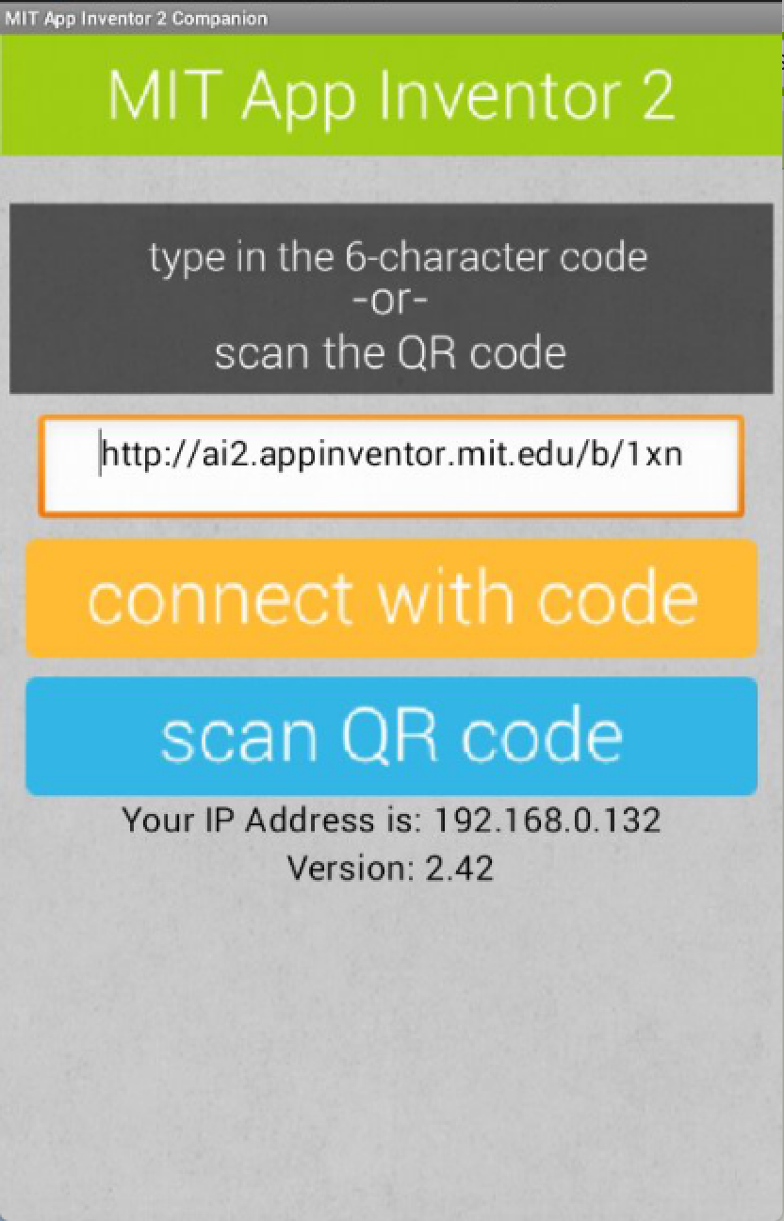
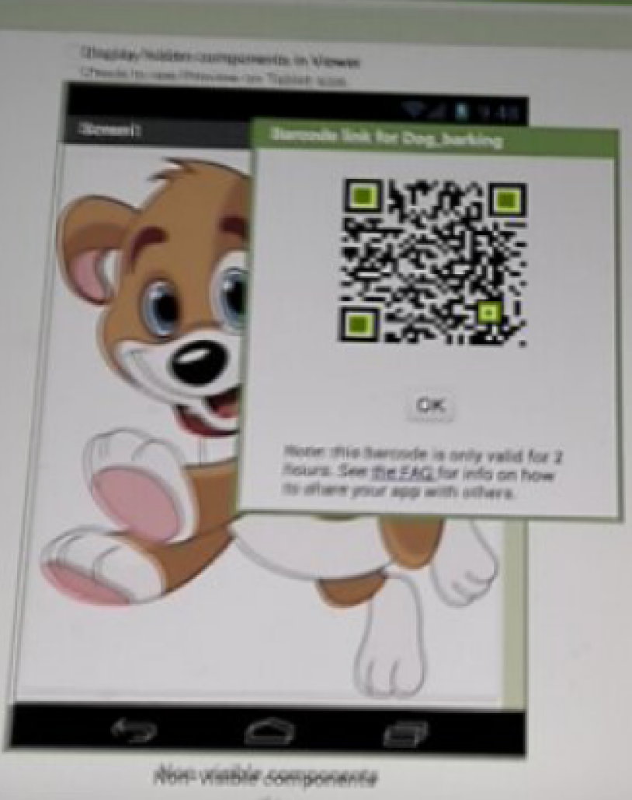
1) Barking dog
QR code 를 폰 카메라로 인식하면 된다.
폰의 카메라를 PC 화면 QR 코드를 겨냥하고
폰 화면에서 scan QR code 를 터치

Slide 31
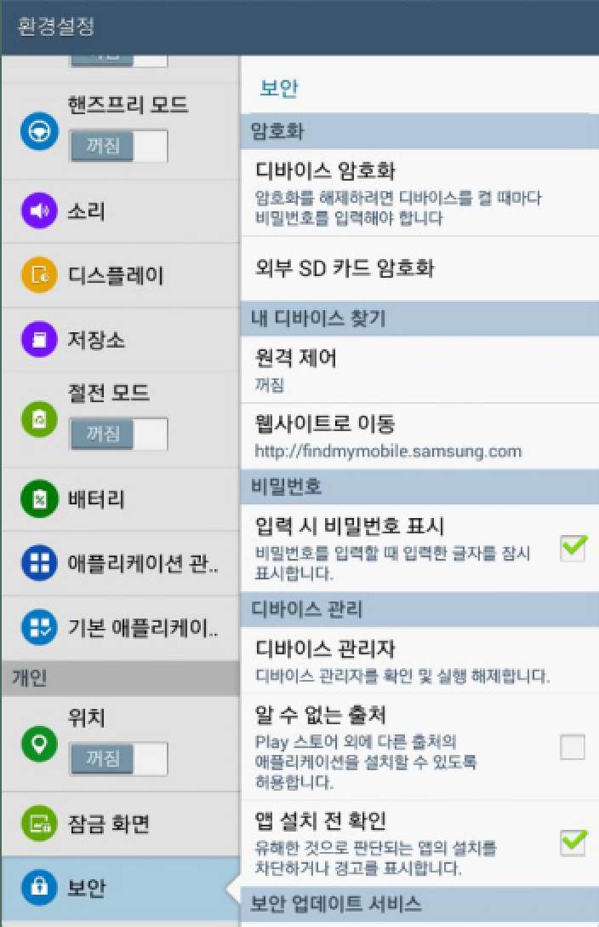
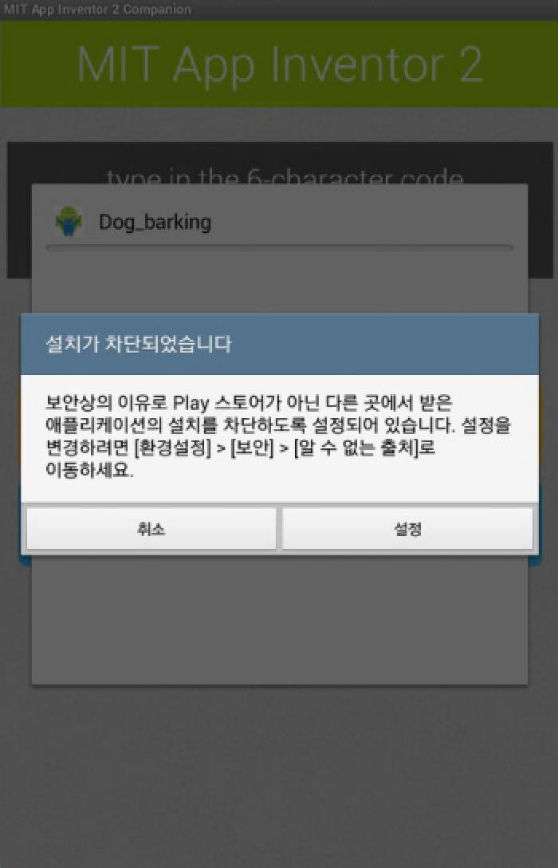

1) Barking dog
환경 설정에서 차단 허용

Slide 32
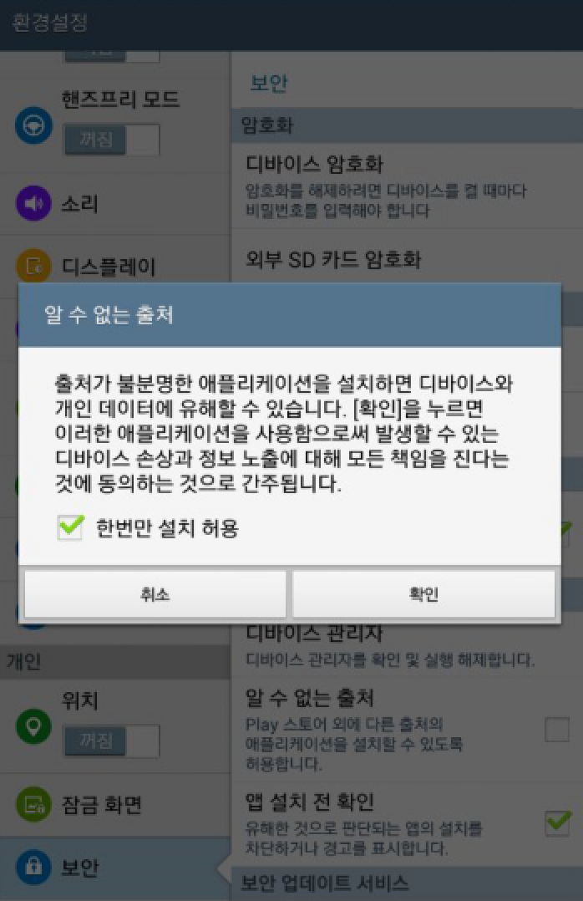
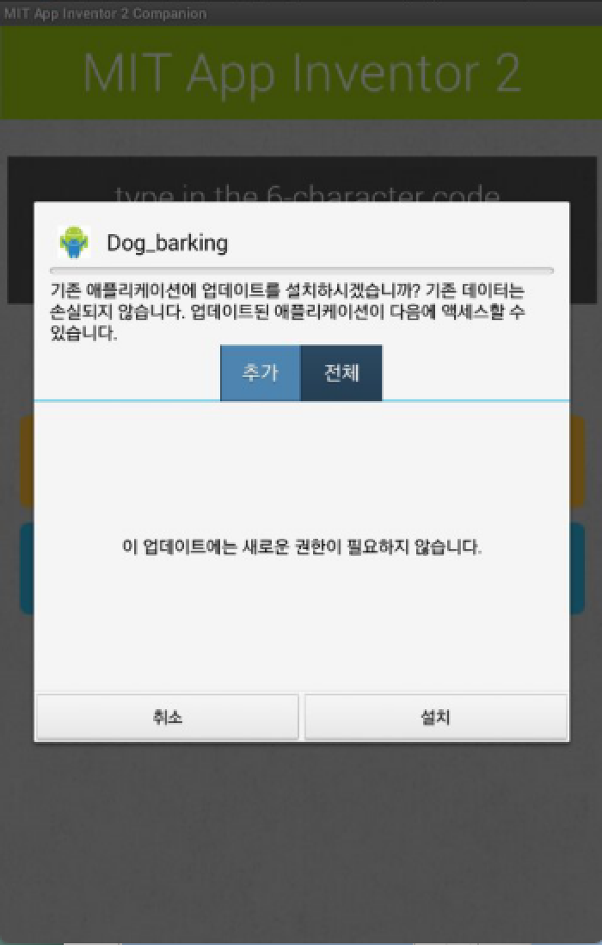
1) Barking dog
허용 및 설치

Slide 33
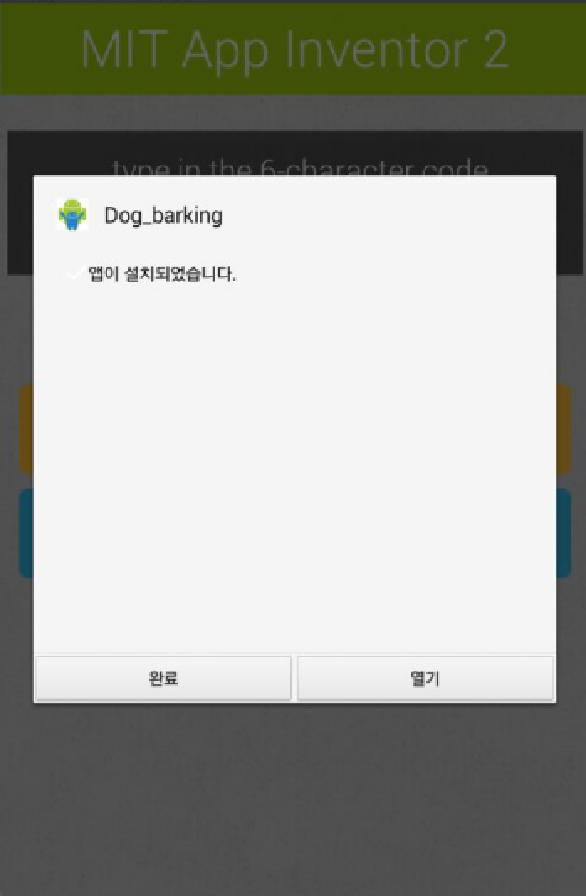
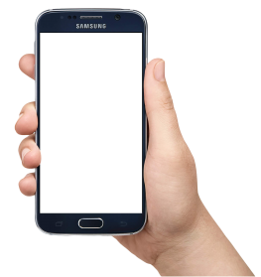
1) Barking dog
열기 및 작동 시키기
Touch the dog

Slide 34

2) Doodle

Slide 35
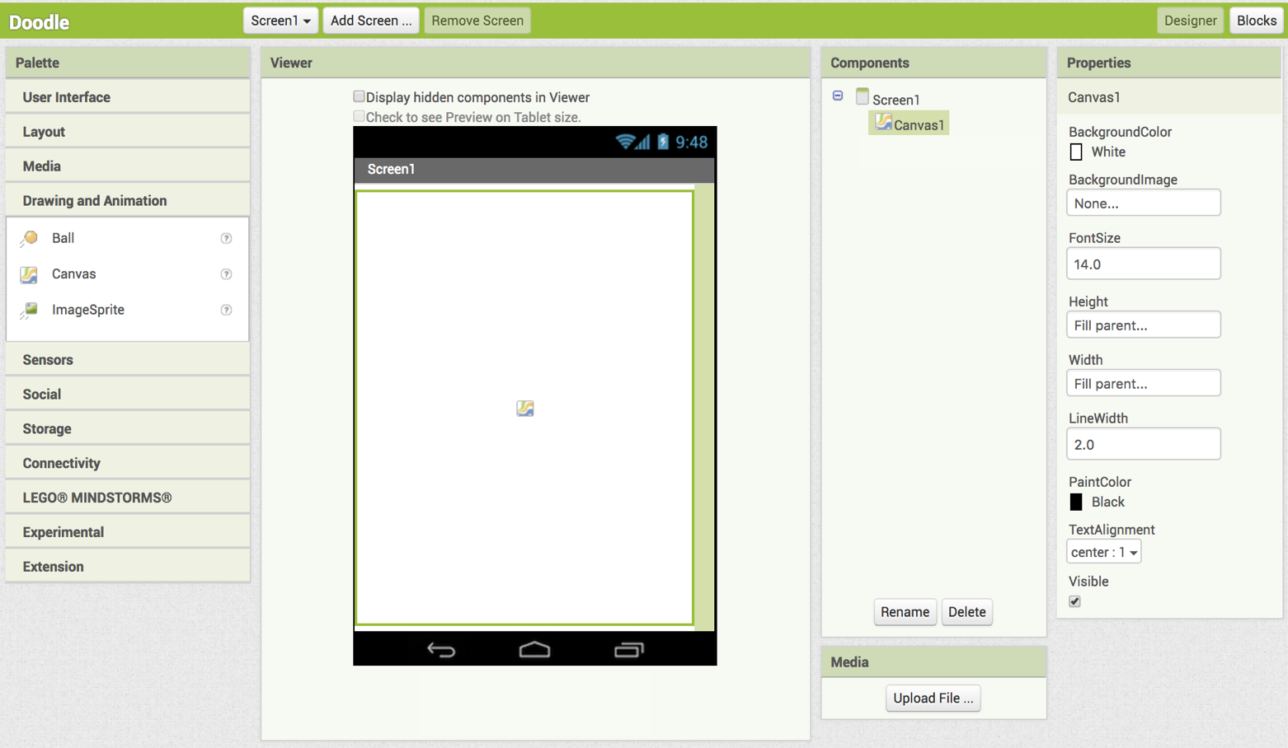
2) Doodle
Canvas from Drawing and Animation to draw pictures,
Make it become full screen, and select line width

Slide 36
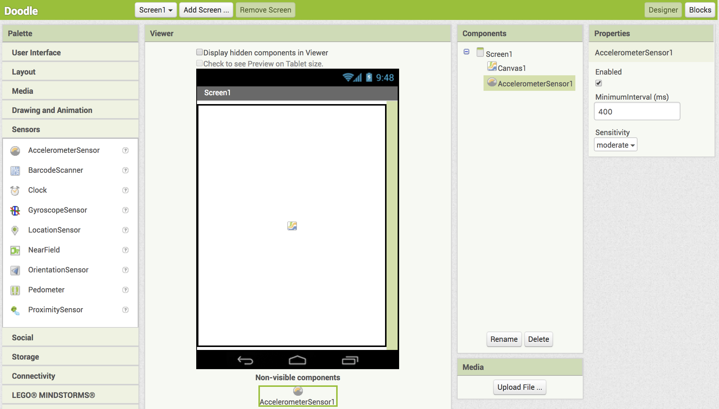
Accelerometer from Sensors
Which is built in hardware in phone.
We will activate this to clean the screen
2) Doodle

Slide 37
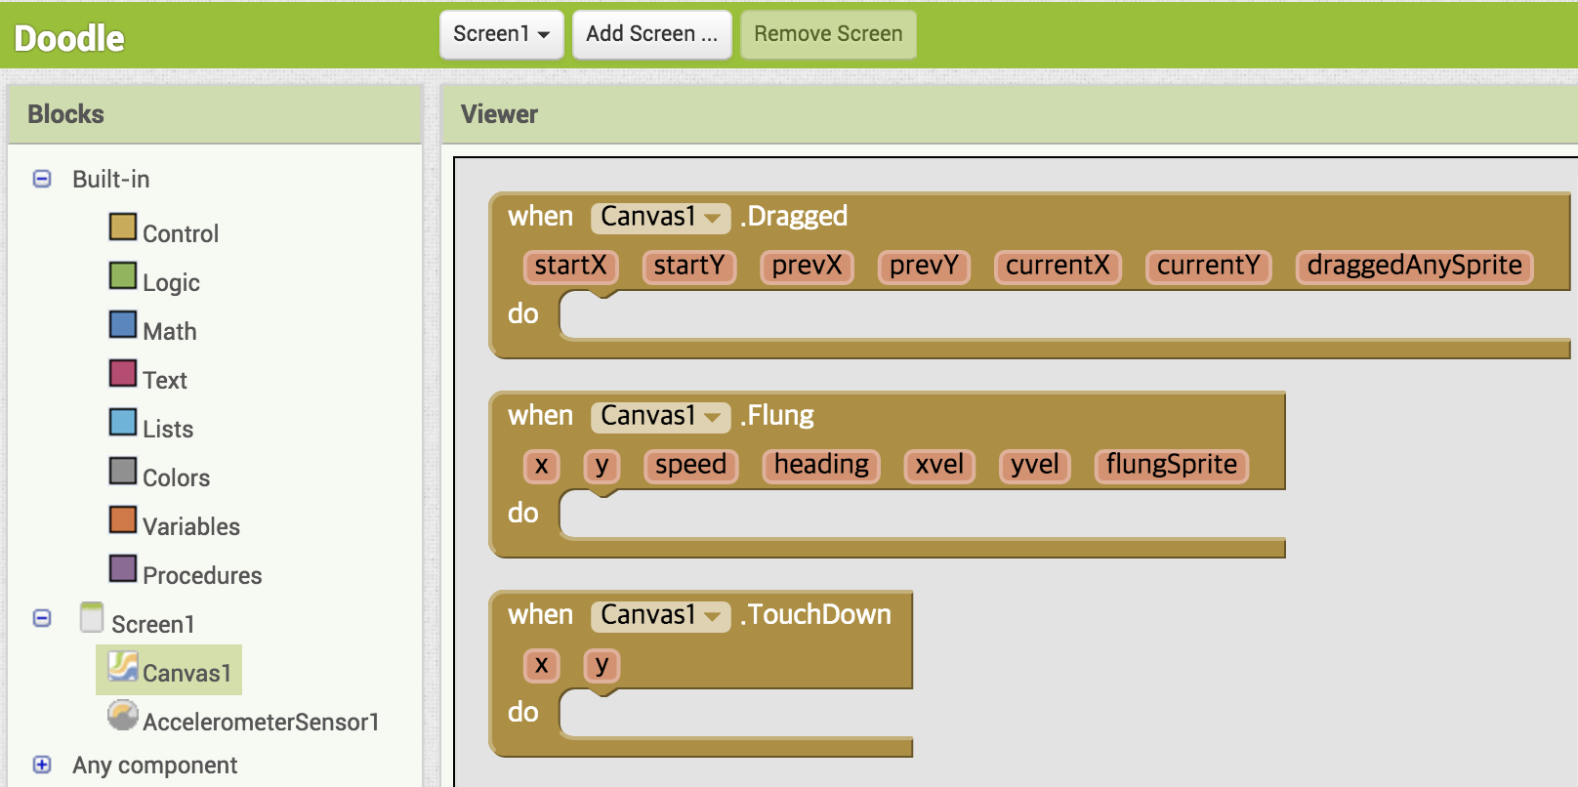
2) Doodle

Slide 38
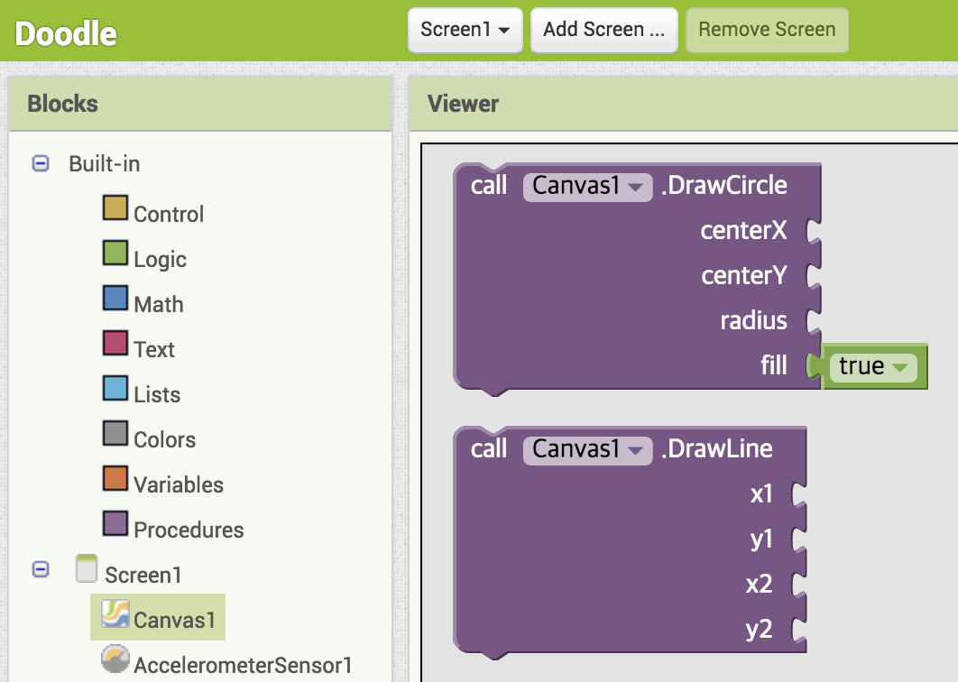
2) Doodle
Take DrawLine to window

Slide 39
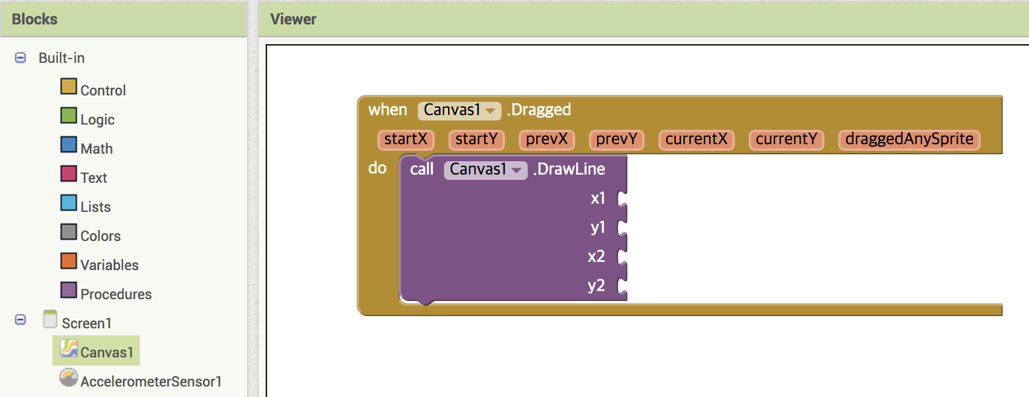
2) Doodle
Combine together

Slide 40
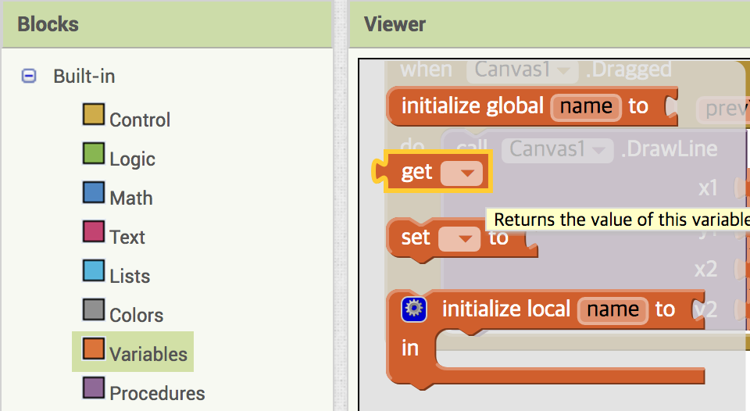
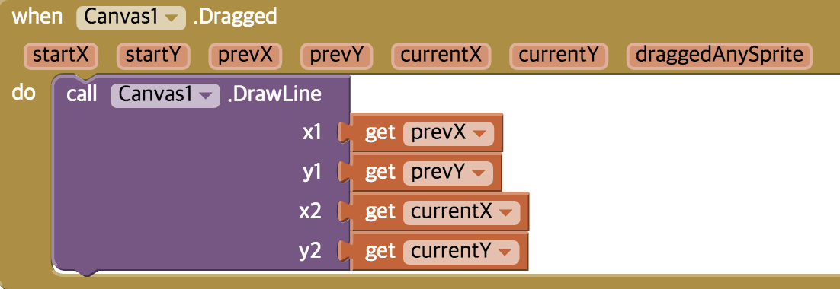
2) Doodle
From Variable take get icon
and put it into call DrawLine.
Select each property

Slide 41
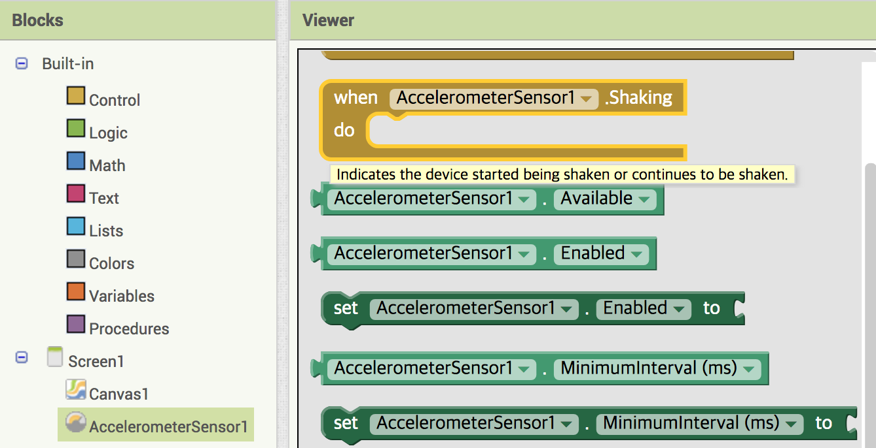
2) Doodle
AccelerometerSensor

Slide 42
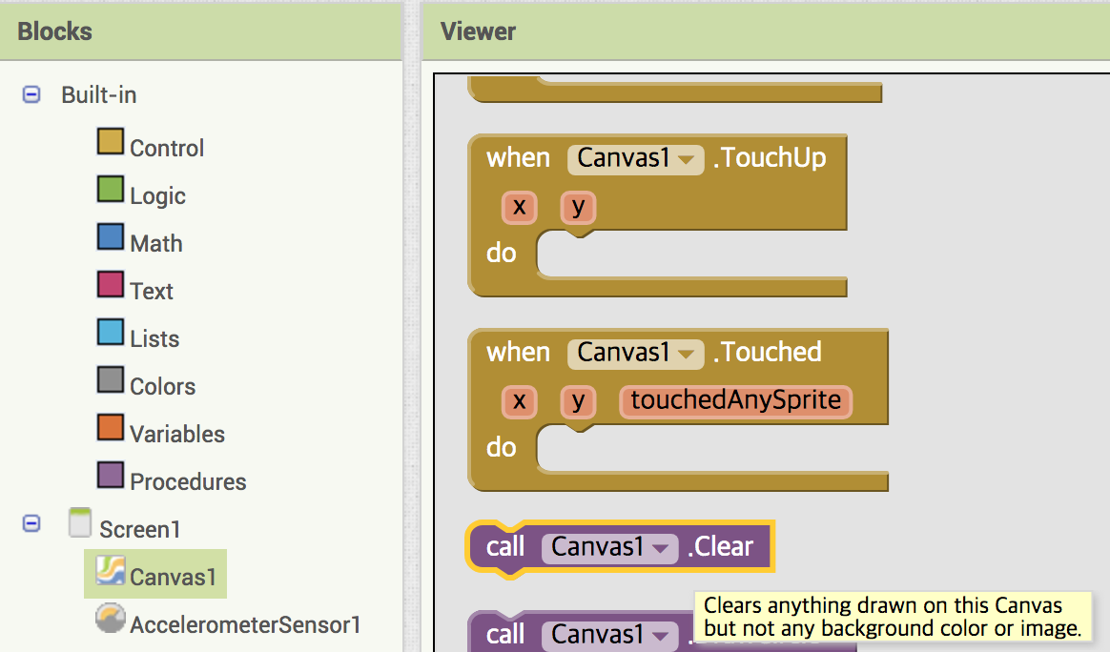
2) Doodle
Canvas1 action

Slide 43
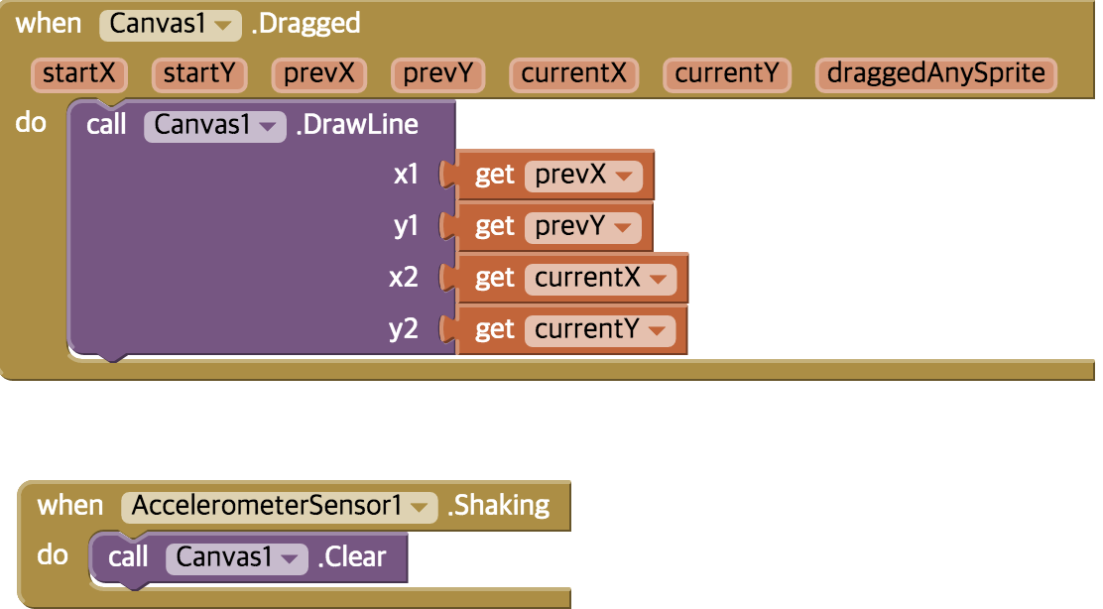
2) Doodle
Block coding complete

Slide 44
2) Doodle
스켄 QR code from phone then 환경 설정에서 앱 허용
or
Save .apk to your computer then transfer to phone

Slide 45
2) Doodle
Draw then shake

Slide 46
Ch10. Bluetooth App making
1) Dog barking
2) Doodle
3) Bluetooth LED control App making
4) Bluetooth auto paring
5) Bluetooth Servo motor control App

Slide 47

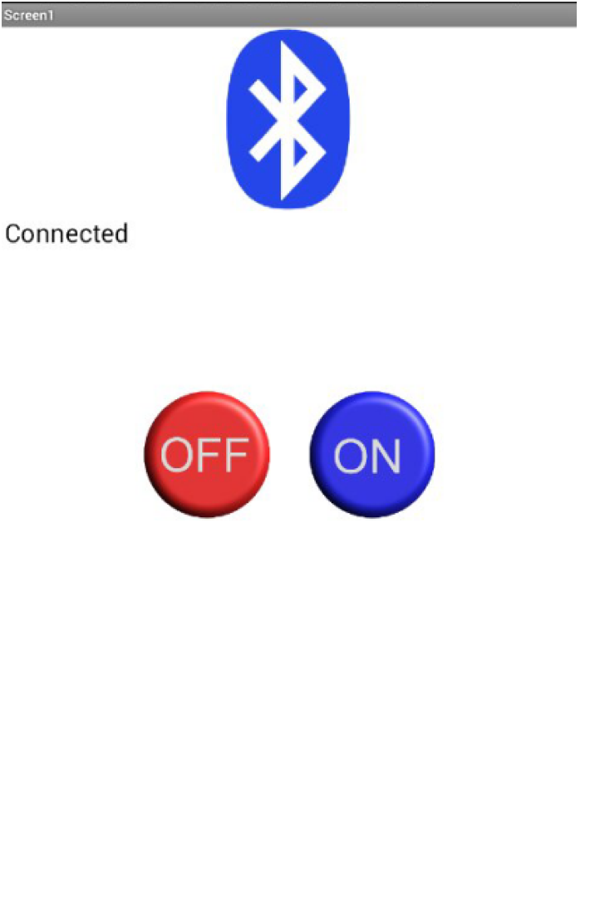
3) LED control App

Slide 48
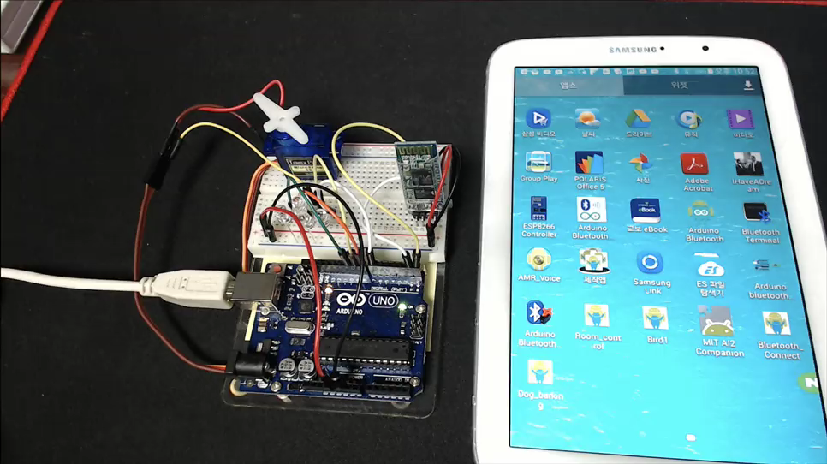
Bluetooth Connect

Slide 49



3) LED control App making
Prepare :
Bluetooth icon image. Size is around 400X400 pixel or smaller
ON, OFF button image

Slide 50
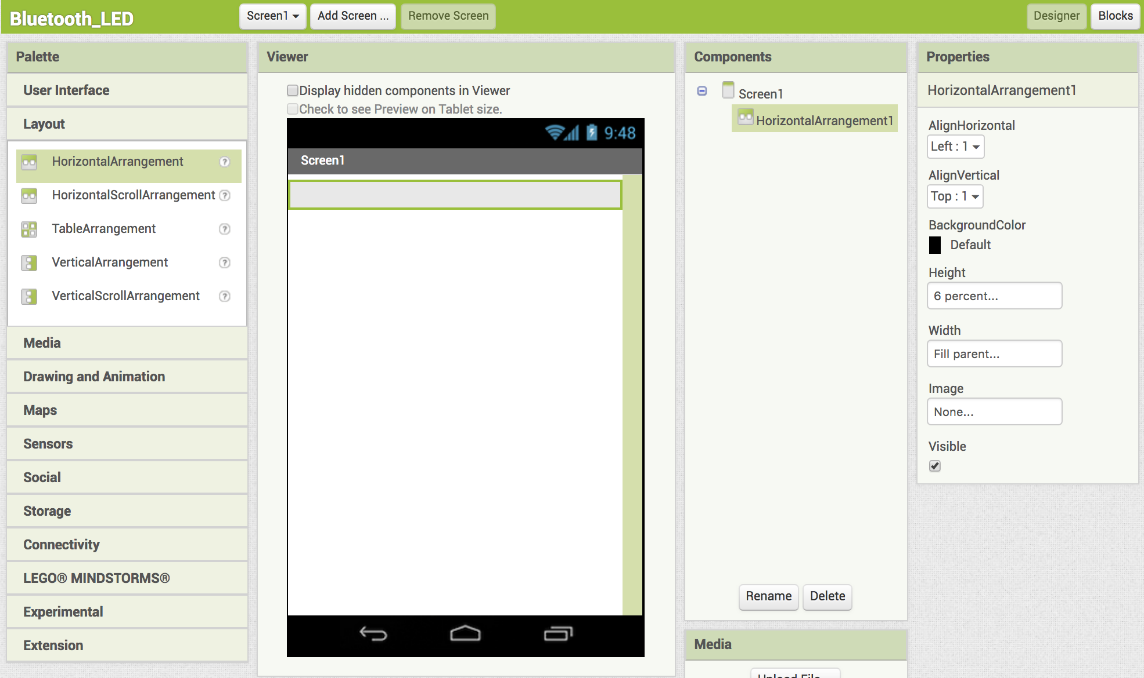
3) LED control App making
This HorizontalArrangement is just for the space in window.

Slide 51

3) LED control App
Now second HorizontalArrangement for the Bluetooth icon.
Height is 70 pixels and Width is Fill parent

Slide 52

3) LED control App
Get ListPicker from User Interface. This is for the Bluetooth icon.

Slide 53

3) LED control App
Get Bluetooth image and adjust size.

Slide 54

3) LED control App
Rename the ListPicker.

Slide 55

3) LED control App
Get 3rd HorizontalArrangement for connectivity message.

Slide 56

3) LED control App
Get 4th HorizontalArrangement for LED status message frame.

Slide 57

3) LED control App
Get 1st Label for LED status

Slide 58

3) LED control App
Get 5th HorizontalArrangement for ON and OFF button.

Slide 59

3) LED control App
Get Button and rename it to ON_Button. Upload ON Button image and adjust to 70X70 pixels

Slide 60

3) LED control App
Final shape of ON_Button.

Slide 61

3) LED control App
Get VerticalArrangement for space between Buttons

Slide 62

3) LED control App
Get Button and rename it to ON_Button. Upload ON Button image and adjust to 70X70 pixels

Slide 63

3) LED control App
Get BluetoothClient

Slide 64

3) LED control App
Get Clock

Slide 65

3) LED control App
Get 2nd Label for Bluetooth connectivity

Slide 66
3) LED control App
Now Block coding

Slide 67

3) LED control App
From Bluetooth_List

Slide 68

3) LED control App
Again from Bluetooth_List

Slide 69

3) LED control App
From BluetoothClient

Slide 70

3) LED control App
From Bluetooth_List

Slide 71

3) LED control App
Again from Bluetooth_List

Slide 72

3) LED control App
From BluetoothClient

Slide 73

3) LED control App
From Bluetooth_List

Slide 74

3) LED control App
From ON_Button

Slide 75

3) LED control App
From BluetoothClient

Slide 76

3) LED control App
From Text

Slide 77

3) LED control App
Write “on”

Slide 78

3) LED control App
From Label1

Slide 79

3) LED control App
Duplicate group of Block

Slide 80

3) LED control App
Duplicated Block group

Slide 81

3) LED control App
Rename by selecting and writing

Slide 82

3) LED control App
Get from Clock

Slide 83

3) LED control App
From Control

Slide 84

3) LED control App
Click setting icon

Slide 85

3) LED control App
Drag else inside of if

Slide 86

3) LED control App
From BluetoothClient

Slide 87

2) LED control App
From Label2

Slide 88

3) LED control App
From text

Slide 89

3) LED control App
From Label2 and Text the coding is complete

Slide 90

3) LED control App
Build the APP

Slide 91

3) LED control App
Build Progress of the APP

Slide 92
3) LED control App
Circuit and Arduino coding

Slide 93






4) Bluetooth LED control with given app
LED control demo.
220 Ω
RX
TX
GND
VCC
1K Ω
2K Ω

Slide 94

Sketch for LED control

Slide 95

3) LED control App

Slide 96
4) Bluetooth Auto paring

Slide 97

4) Bluetooth Auto paring

Slide 98

4) Bluetooth Auto paring

Slide 99

4) Bluetooth Auto paring

Slide 100

4) Bluetooth Auto paring

Slide 101
5) Servo motor control App
디지털 및 아날로그 슬라이드 컨트롤

Slide 102



Bluetooth Servo motor control
1K Ω
2K Ω

Slide 103


Slide 104


Slide 105

Bluetooth Servo motor control

